Slide 1
Scene mapping using a RGB-D sensor from an UAV
Katrina Ashton: u5586882
Supervisor: Viorela Ila
Australian National University

Slide 2
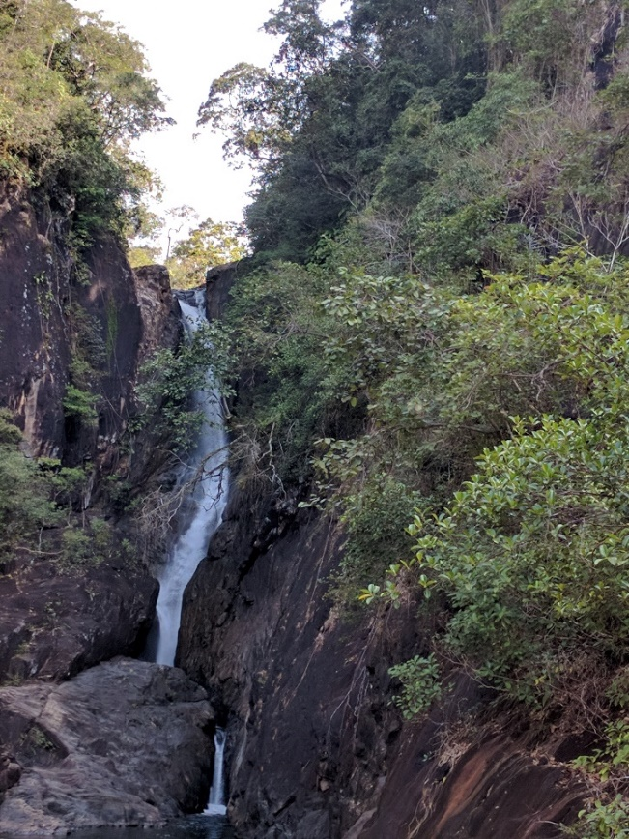
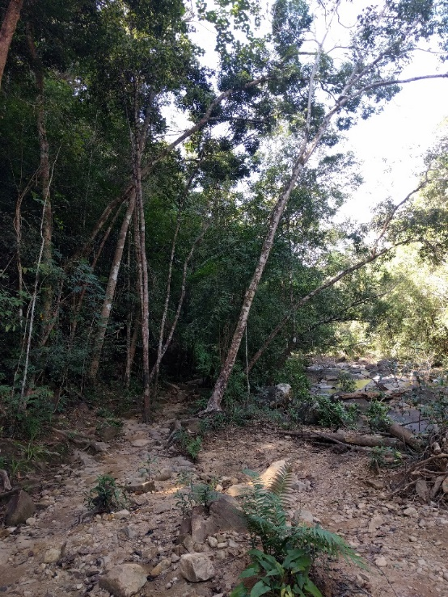
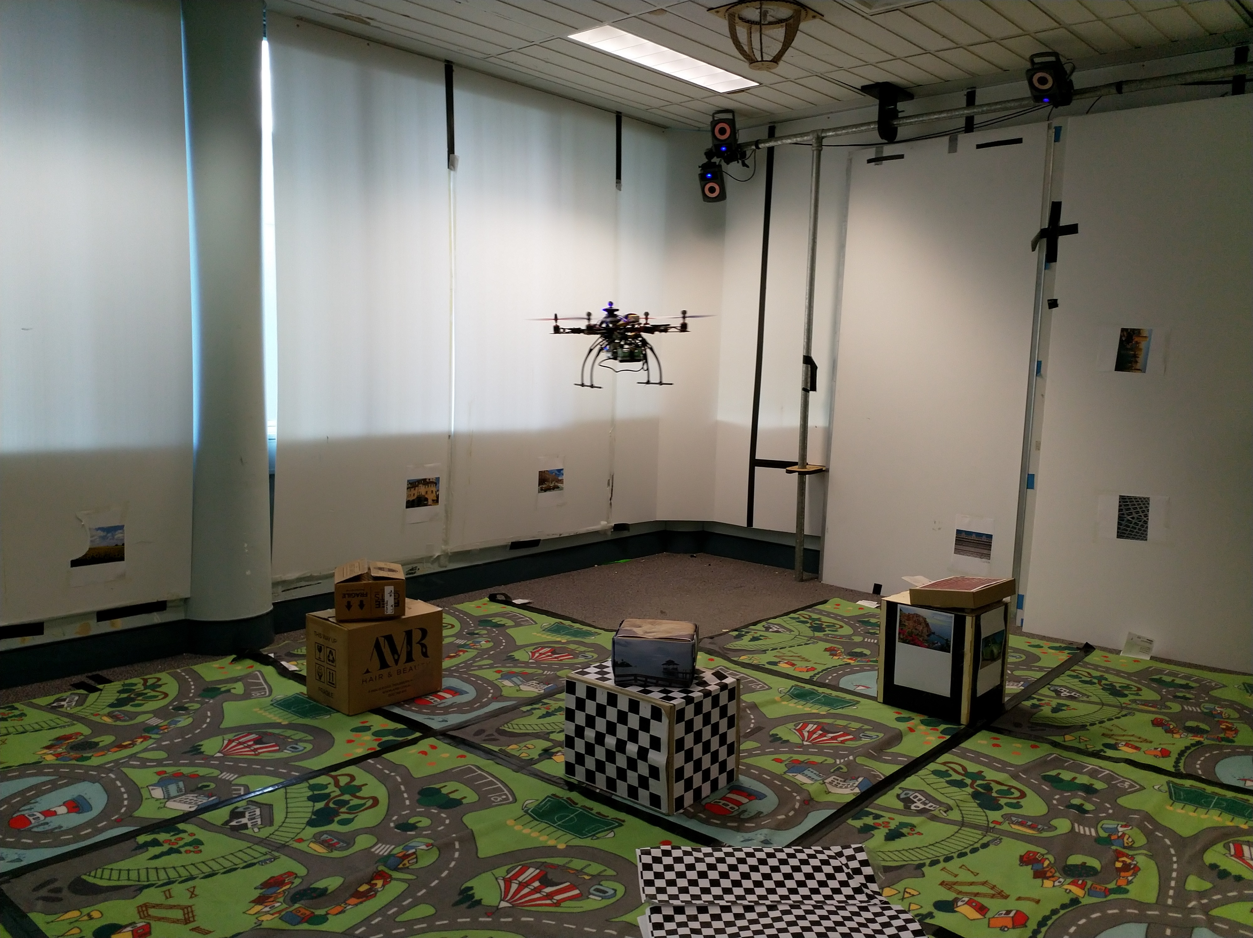
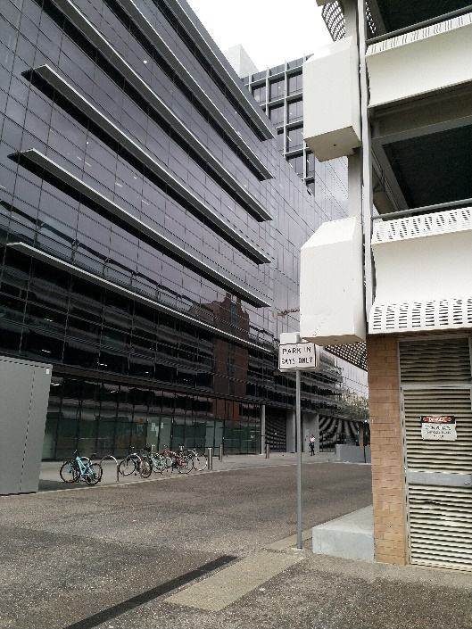
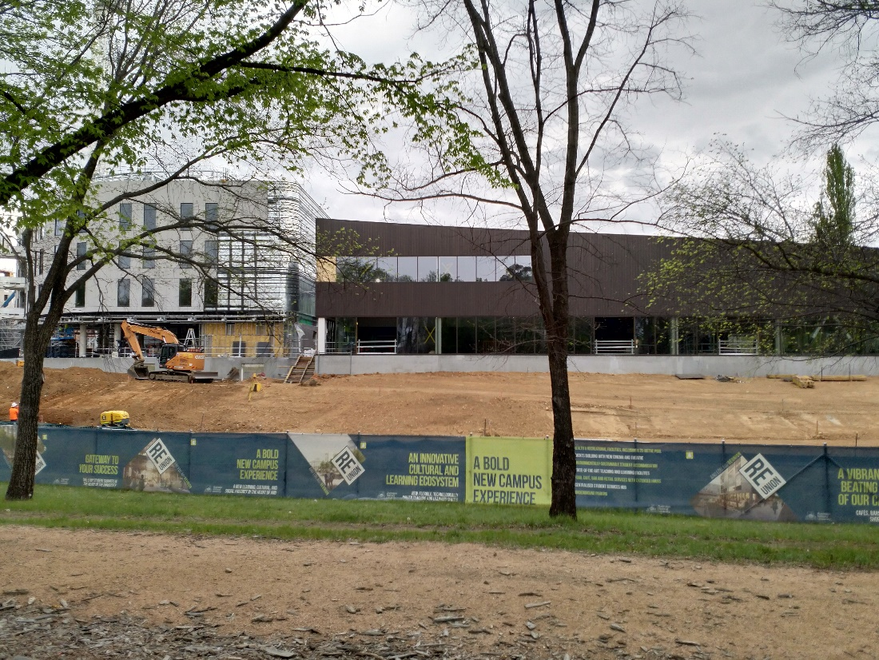
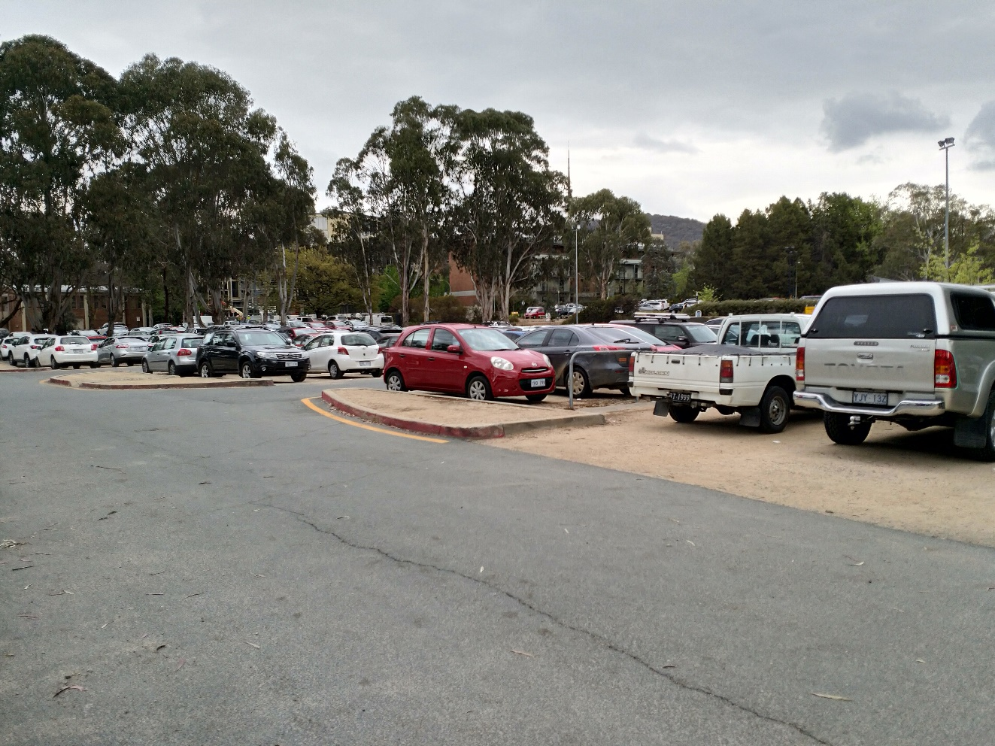
Motivation
Unmanned Aerial Vehicle
(UAV)
Notes:
Add in urban scenes

Slide 3
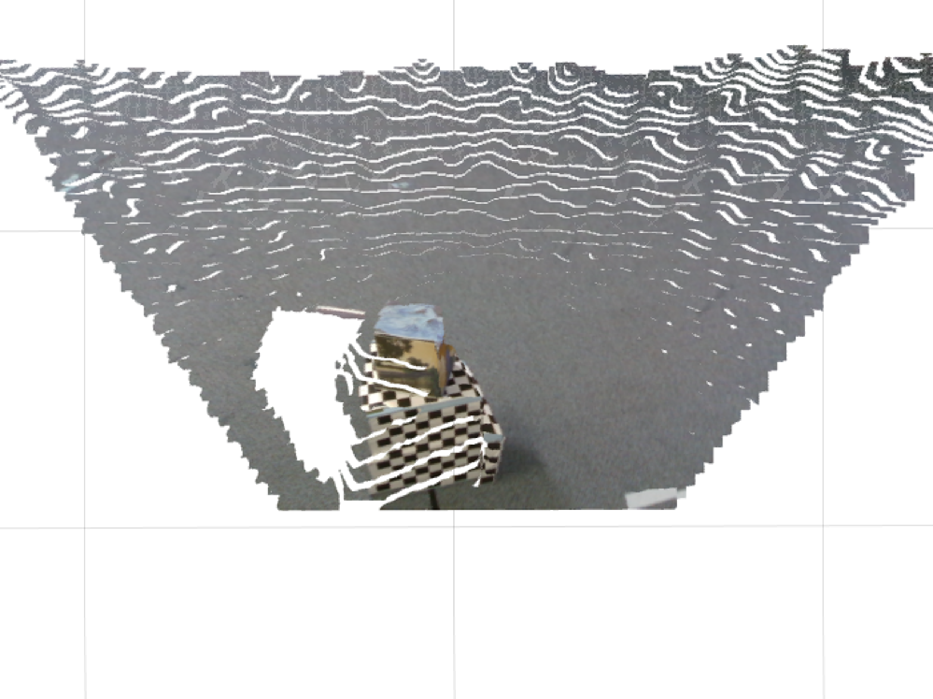
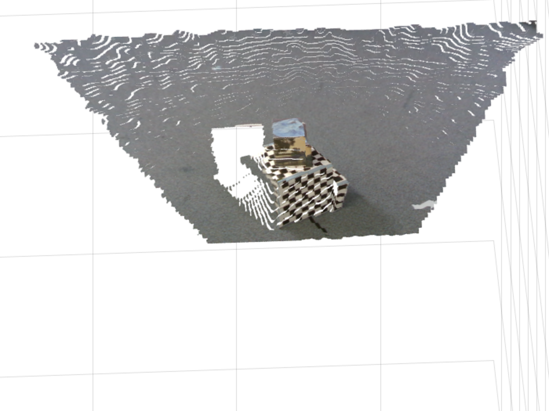
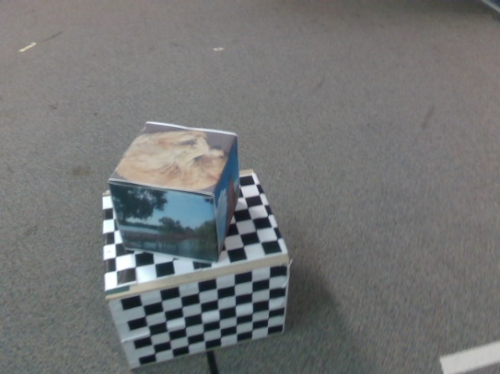
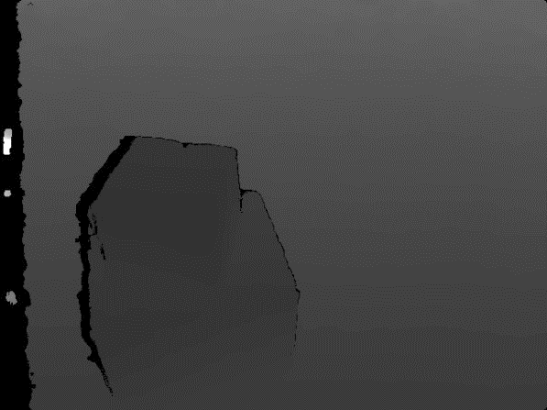
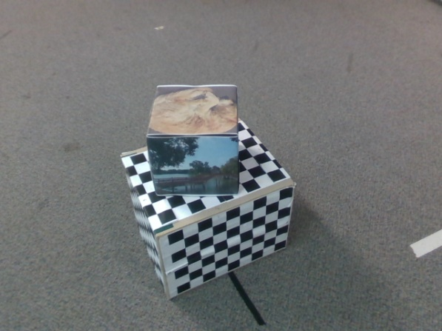
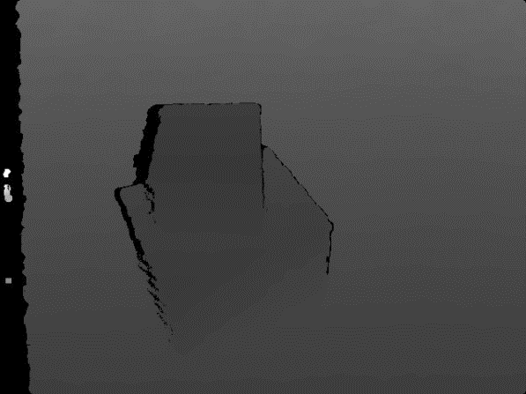
Data registration
Pointcloud
Pointcloud
[R|t]
1
2
RGB image
Depth image
(brightened for visibility)
RGB image
Depth image
(brightened for visibility)
Notes:
Motivation

Slide 4
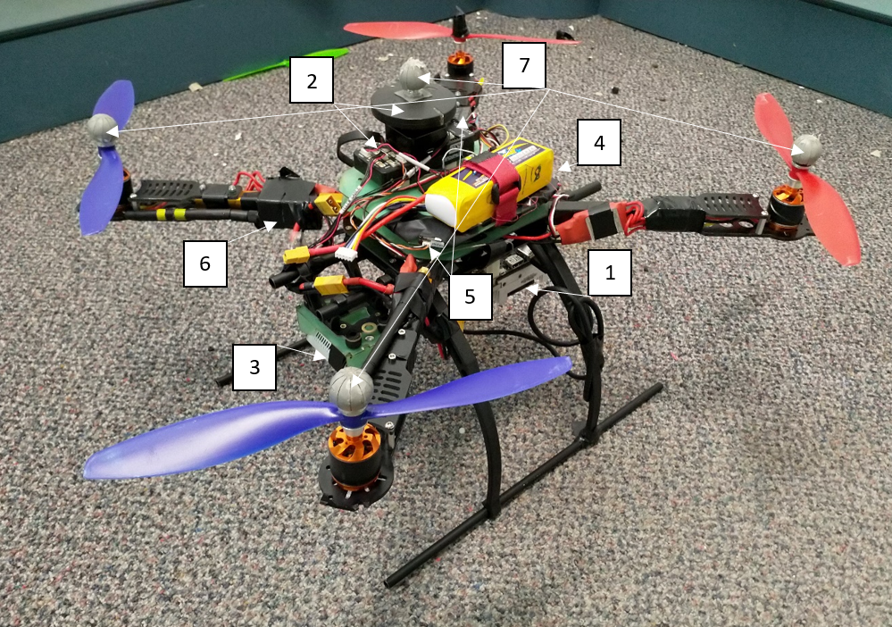
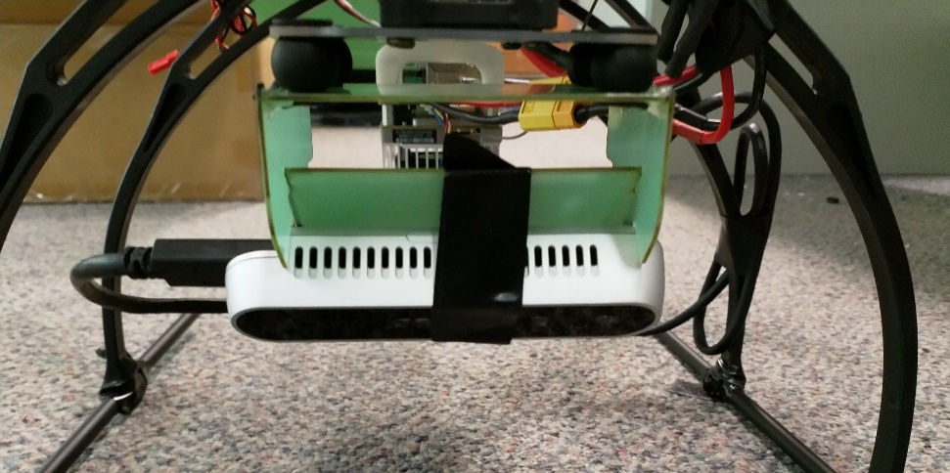
Building Quadcopter
TX2 with Orbitty carrier board
Pixhawk 4 flight controller and GPS
RealSense camera with fixed mount
Lithium polymer battery
Receiver
Radio
Vicon markers
3

Slide 5
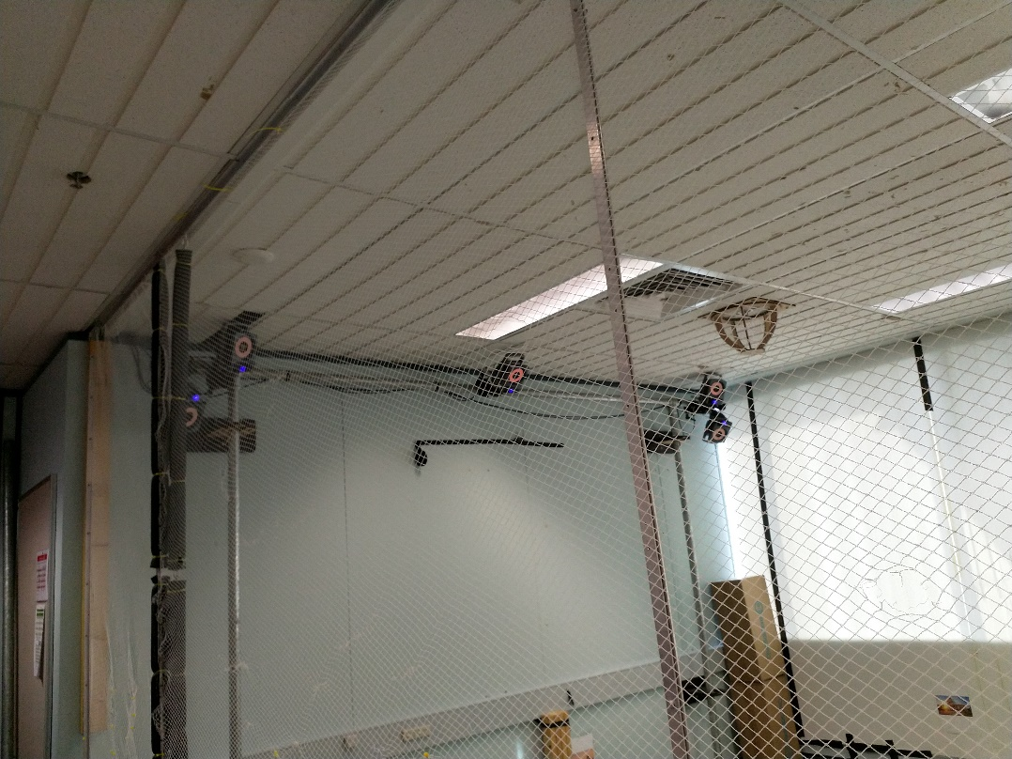
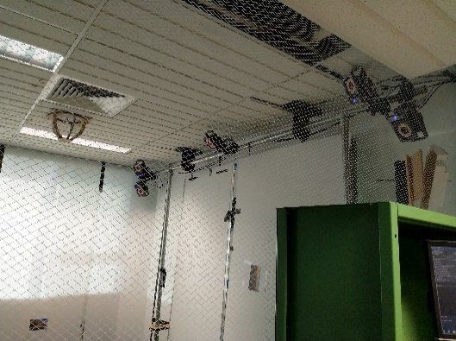
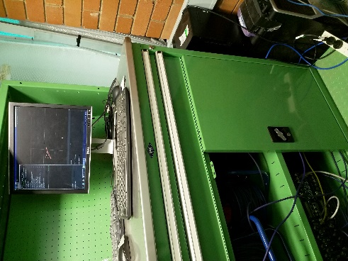
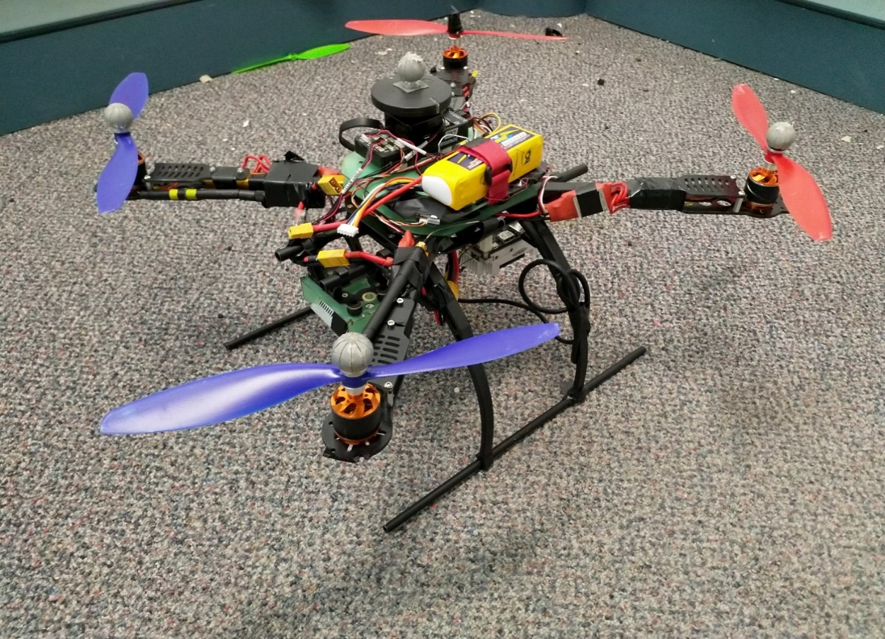
Vicon system
Vicon computer
IR cameras
Vicon markers

Slide 6
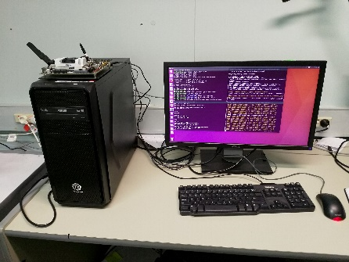
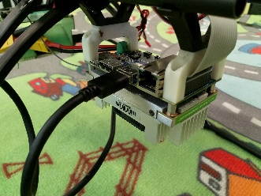
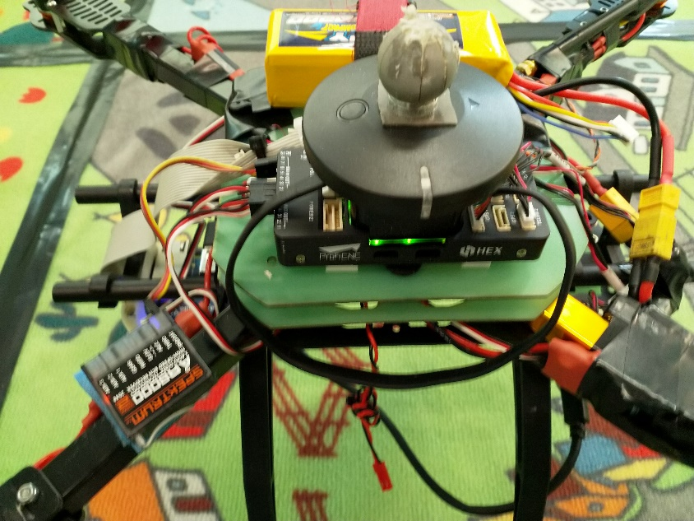
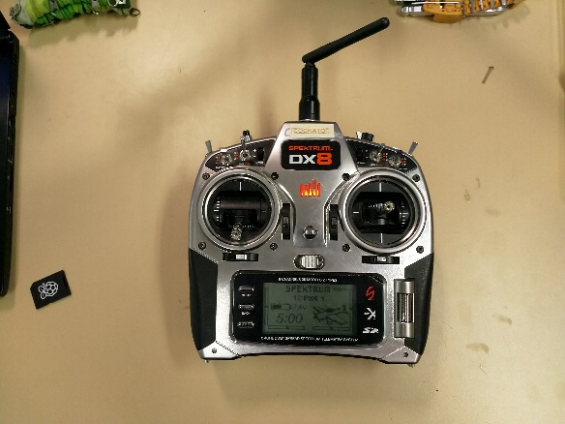
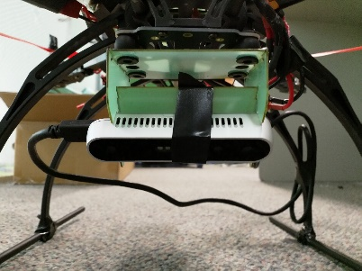
System
mavros (ROS)
SSH
TX2
Work station
vicon_bridge (ROS)
Vicon computer
Radio
USB
ROS
Telemetry cable
Pixhawk
Transmitter
Receiver
RealSense

Slide 7
Collecting data - trajectories
Circle
Rectangle
Lawnmower
0.5m
1m
2m
1m
1m
2 loops
Quad facing inwards
2 loops
Quad facing inwards
Mirrored trajectory back
Quad facing forwards

Slide 8
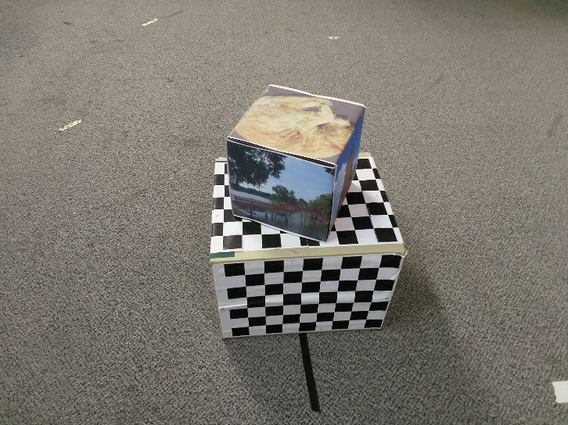
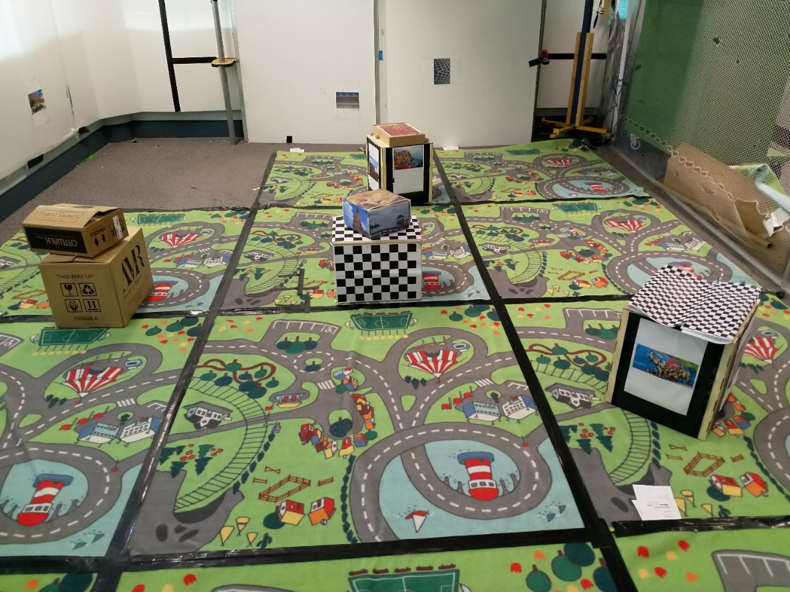
Collecting data - Scene

Slide 9
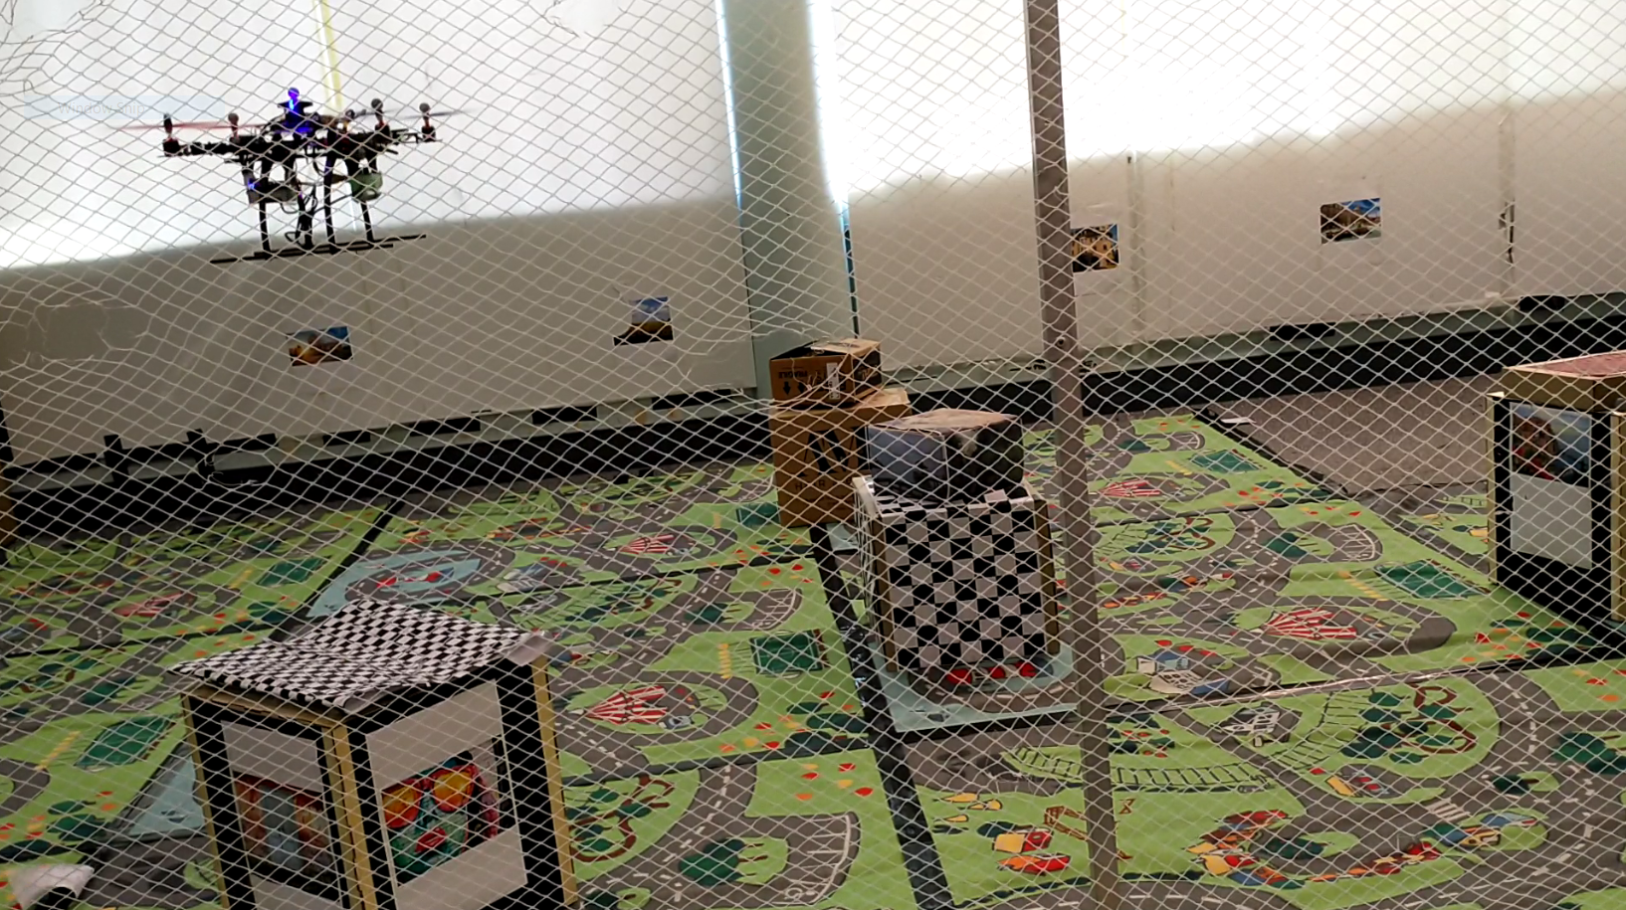
Frames

Slide 10
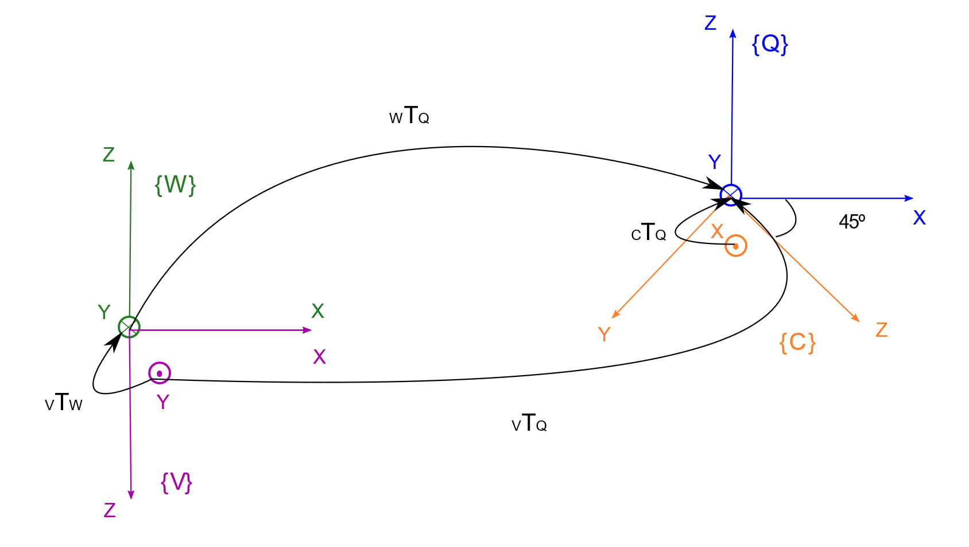
Frames
Quadcopter
World
Camera
Vicon
Notes:
Split up?

Slide 11
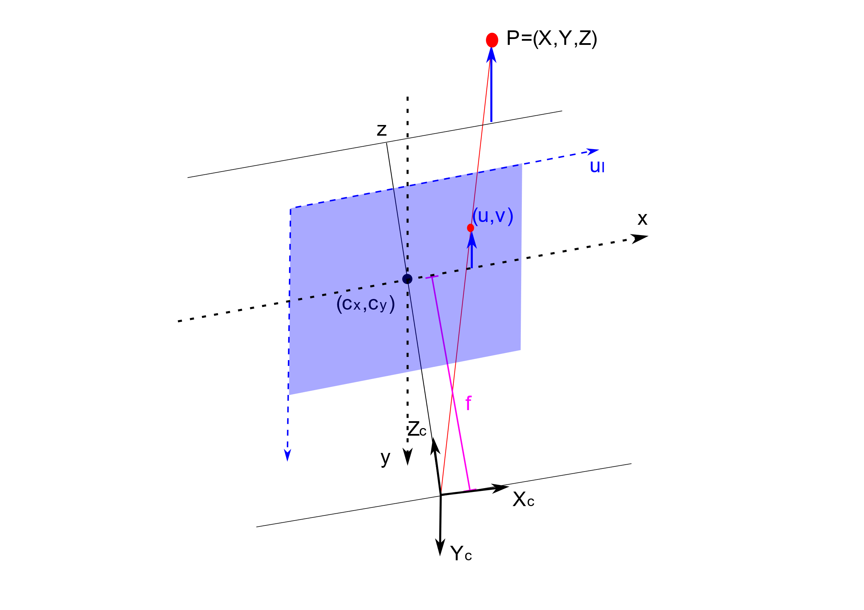
Frames

Slide 12
Projective geometry
3D
2D
Frame 1
Frame 2
Camera 1
Camera 2

Slide 13
Registration techniques
Essential Matrix
RGB data
Epipolar geometry
Nister’s 5-point algorithm (Nister 2003)
Kabsch
3D data
3D point cloud registration for known correspondences
SVD implementation (Kavraki 2009)
PnP
2D and 3D data
Projective geometry
EPnP (Lepetit 2009)

Slide 14
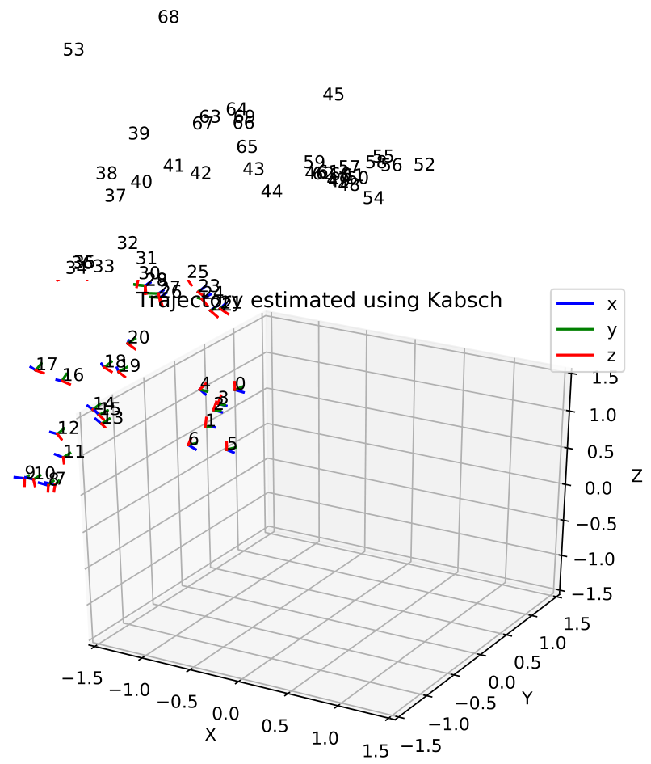
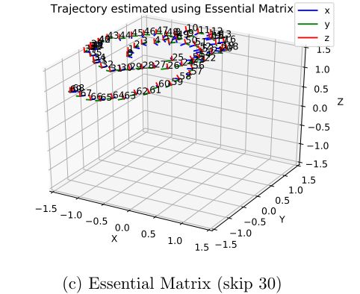
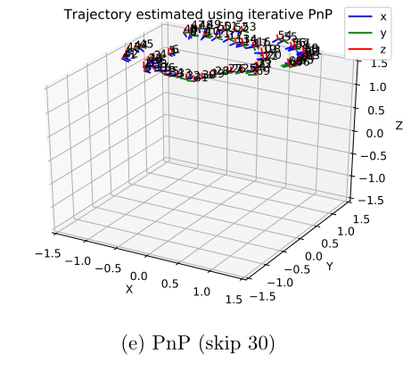
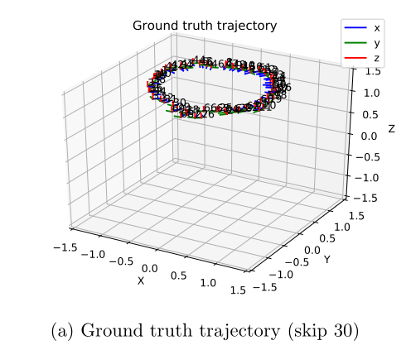
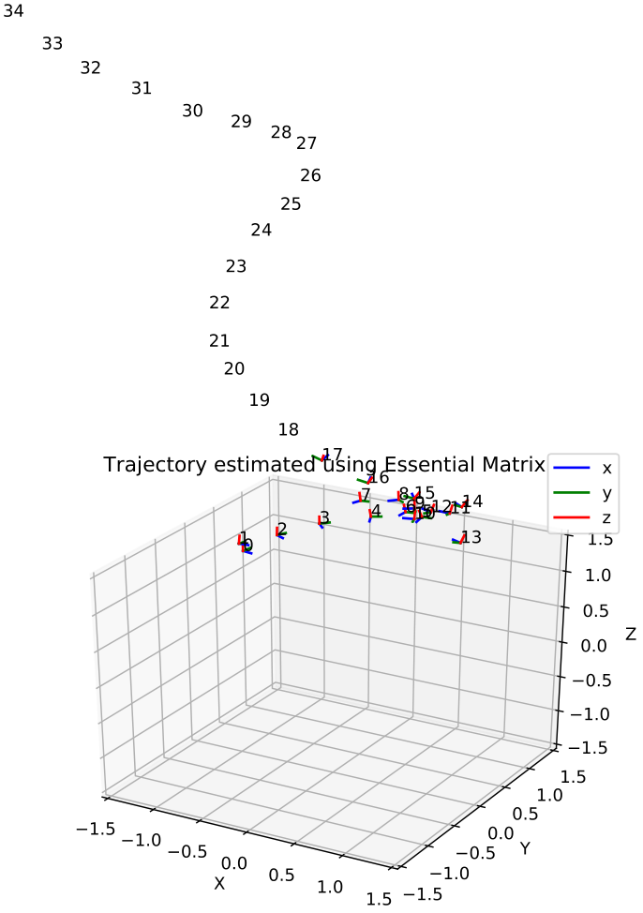
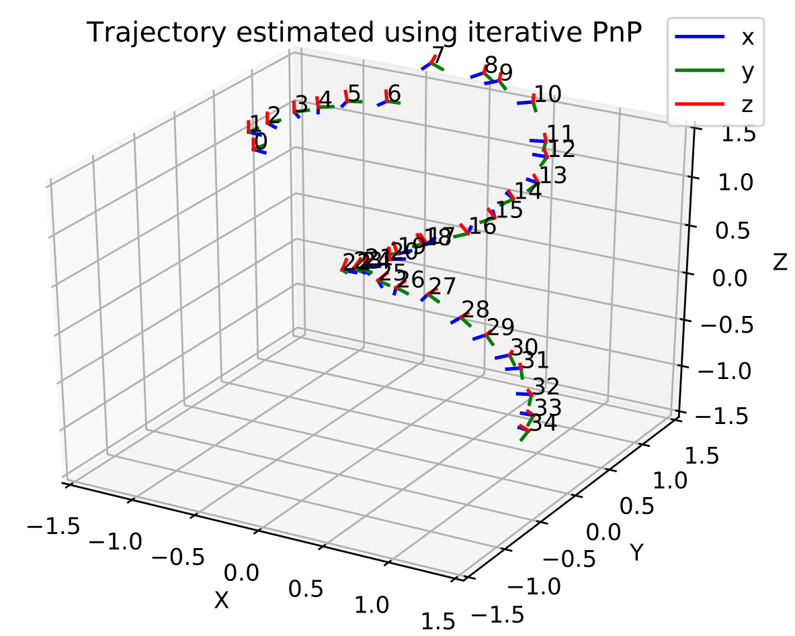
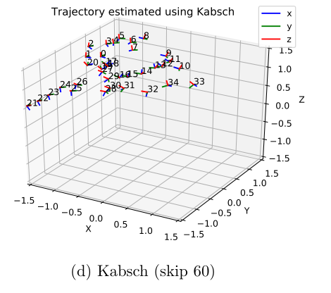
Results – processing frequency
30 frames skipped
60 frames skipped
Essential Matrix
PnP
Kabsch
Notes:
Different numbers of skips

Slide 15
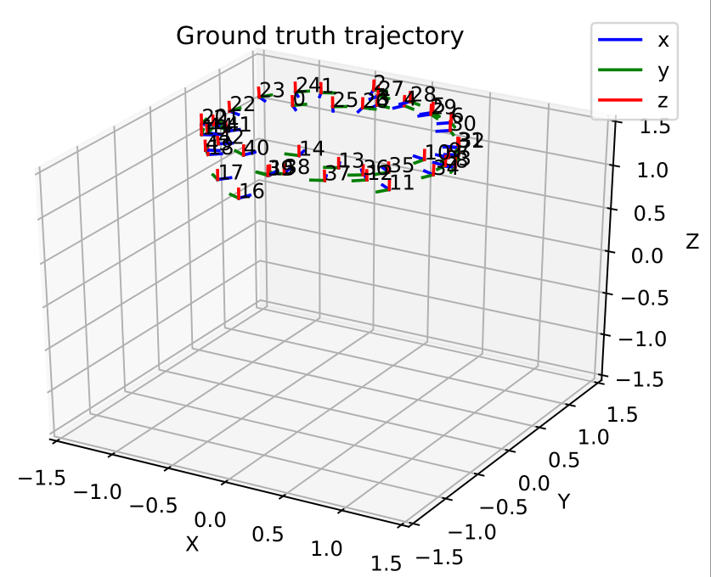
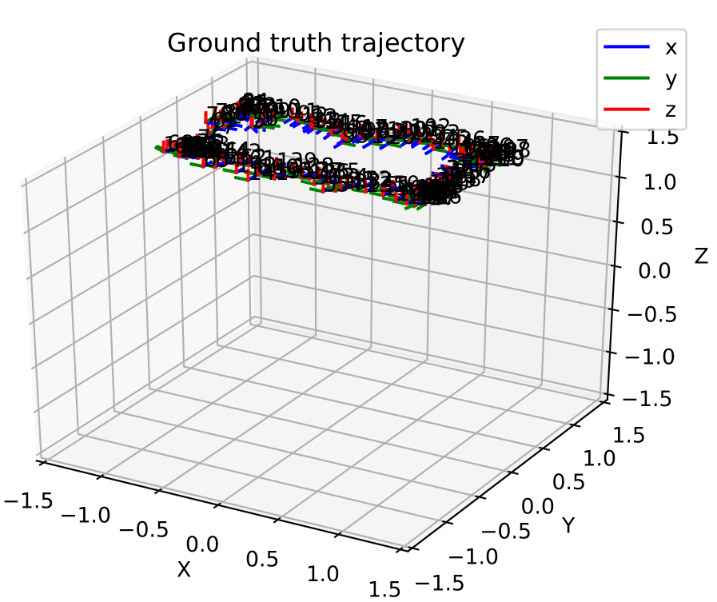
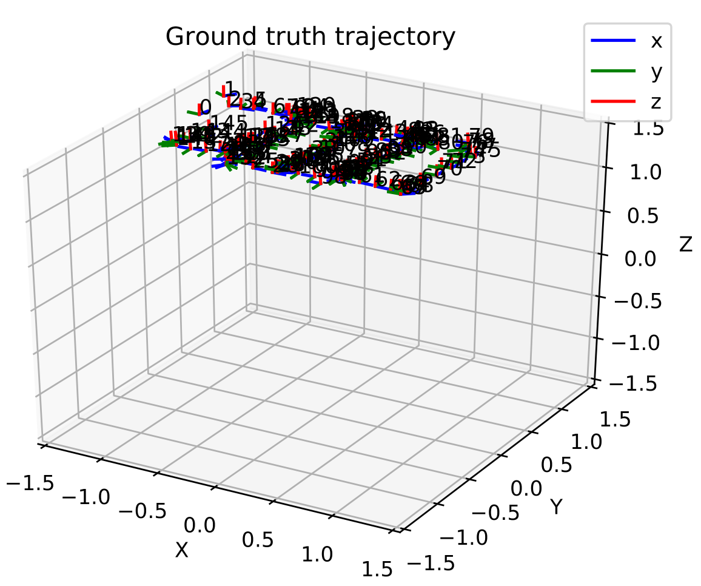
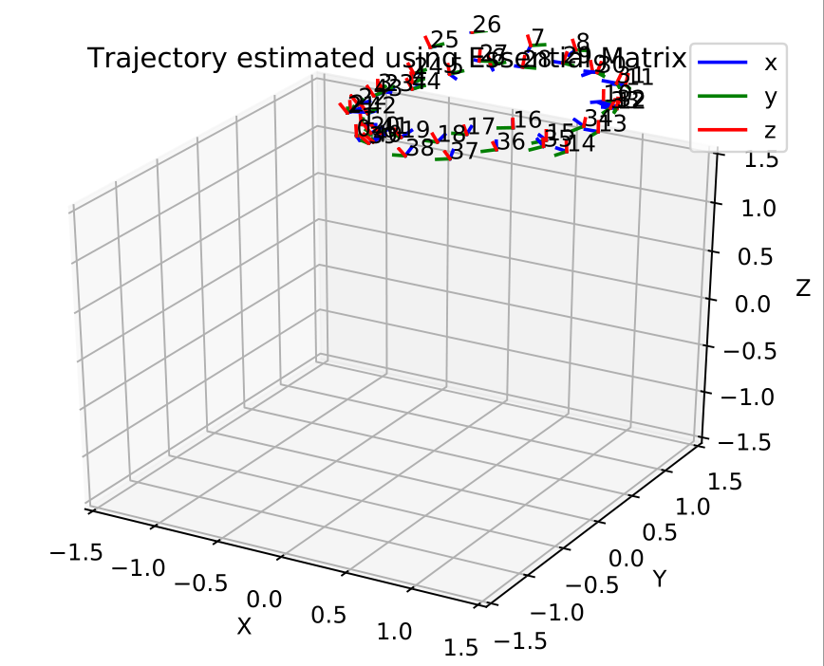
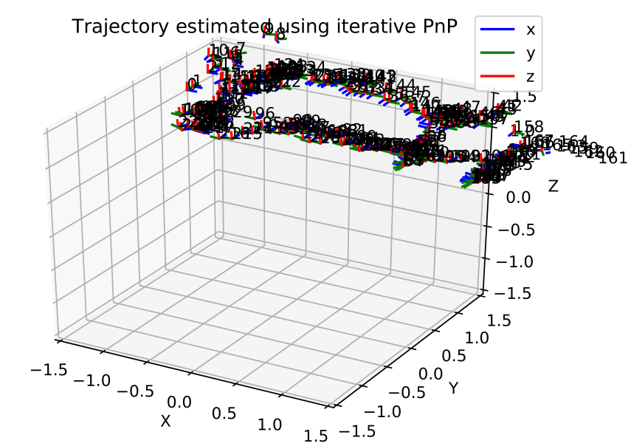
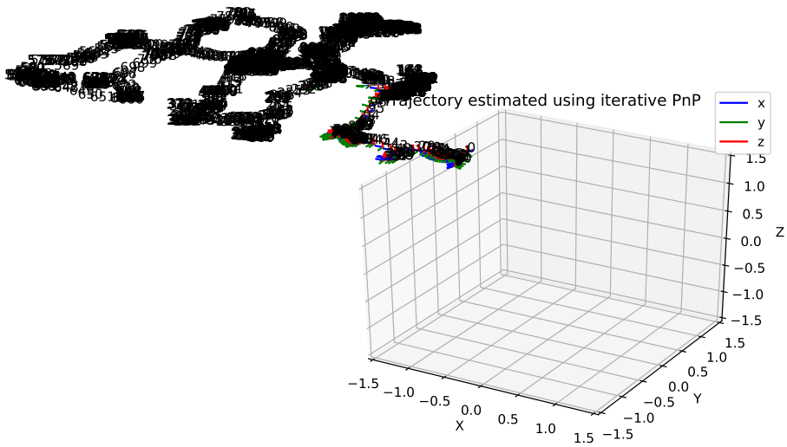
Results - trajectories
Ground truth
Best estimated trajectory
Notes:
Different trajectories

Slide 16
Conclusions and future work
Conclusions
PnP has better accuracy than the Essential Matrix method for the rectangular and lawnmower trajectories, and is similar for the circular one.
PnP is slow
For large motions Kabsch may be better
Extending mapping algorithm
Mapping algorithms often use multiple registration methods
Registration is only one part of mapping – choosing frames, closing loop

Slide 17
References
D. Nister. An efficient solution to the five-point relative pose problem. In Computer
Vision and Pattern Recognition, 2003. Proceedings. 2003 IEEE Computer Society
Conference on, volume 2, pages II–195. IEEE, 2003.
L. E. Kavraki. Geometric methods in structural computational biology. 2009.
V. Lepetit, F. Moreno-Noguer, and P. Fua. Epnp: An accurate o (n) solution to the
pnp problem. International journal of computer vision, 81(2):155, 2009.

Slide 18
Questions

Slide 19
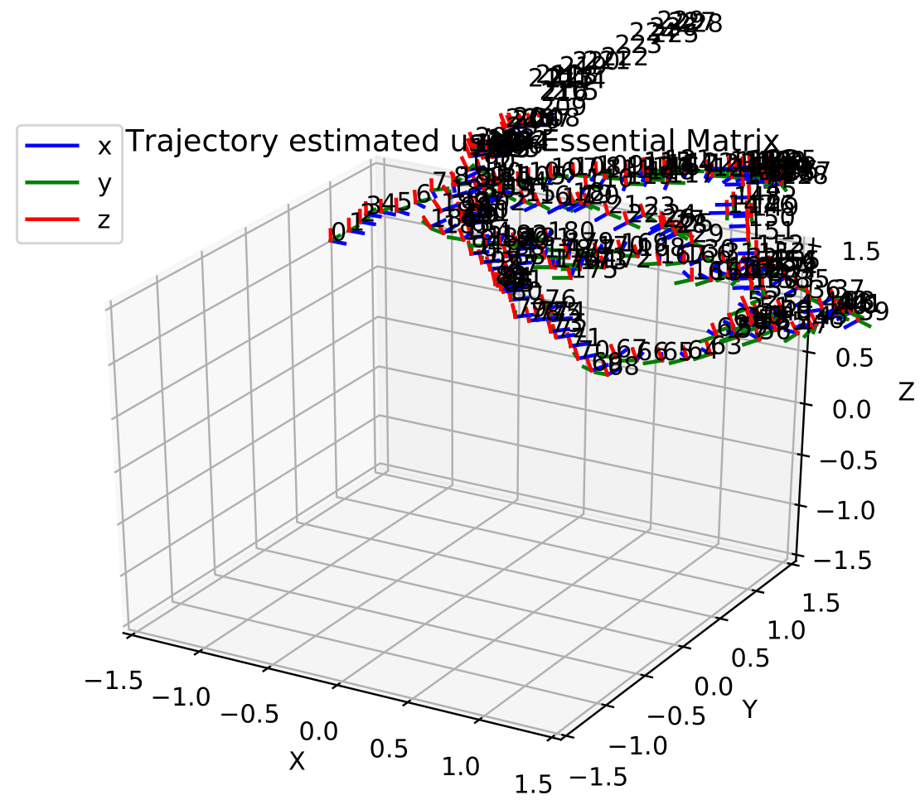
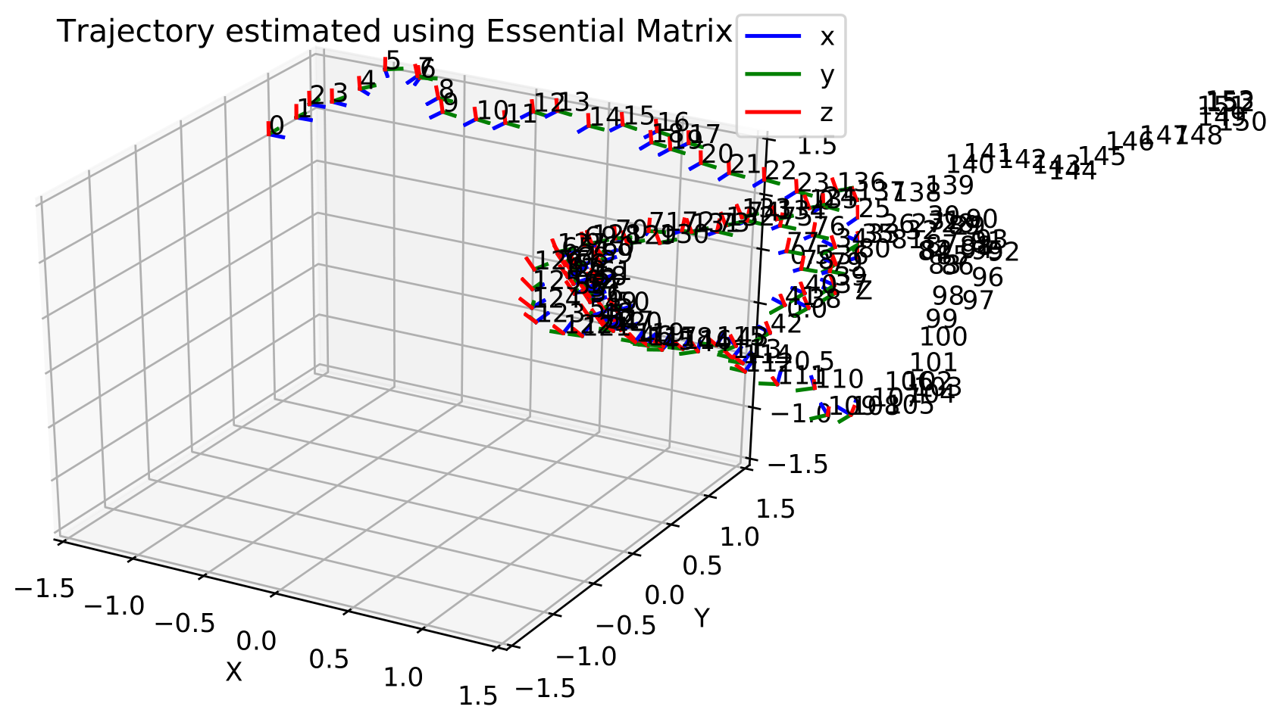
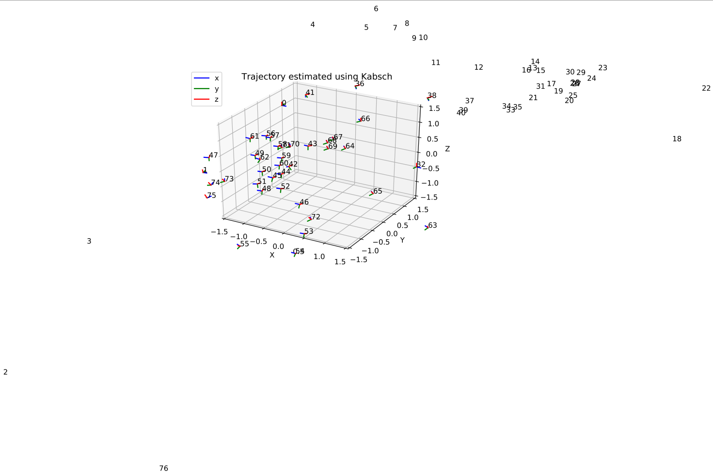
Results – rectangle trajectory
Essential Matrix
(skip 20)
Essential Matrix
(skip 30)
Ground truth
Kabsch
(skip 60)
PnP (skip 20)
Notes:
Different trajectories

Slide 20
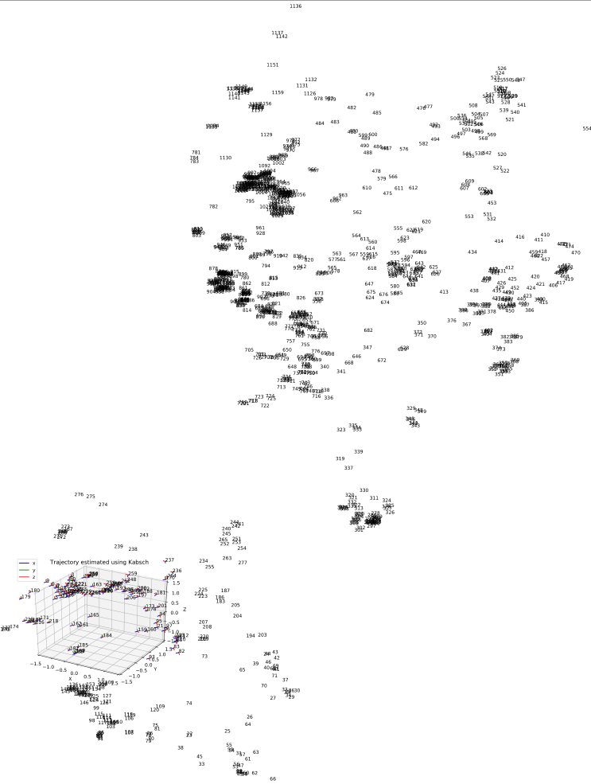
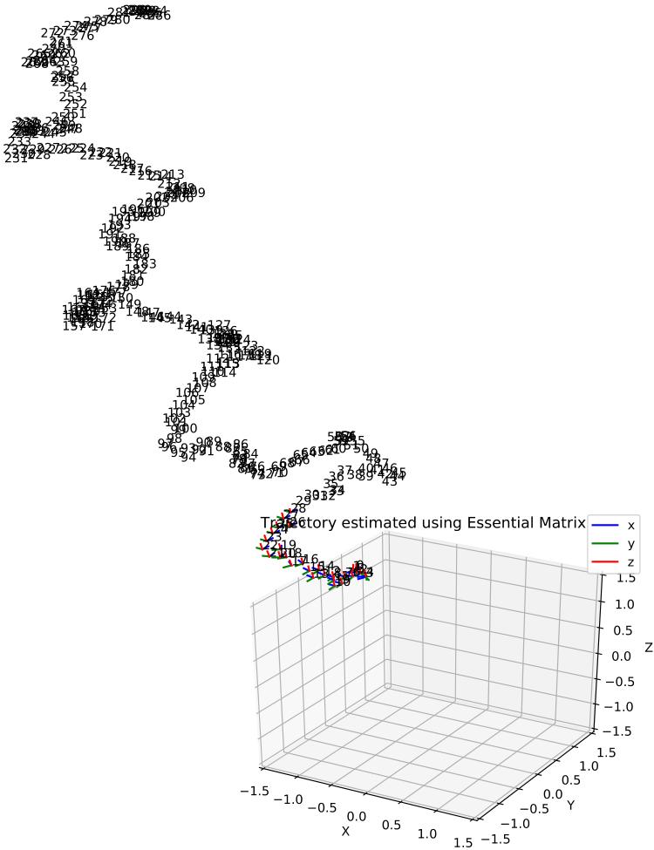
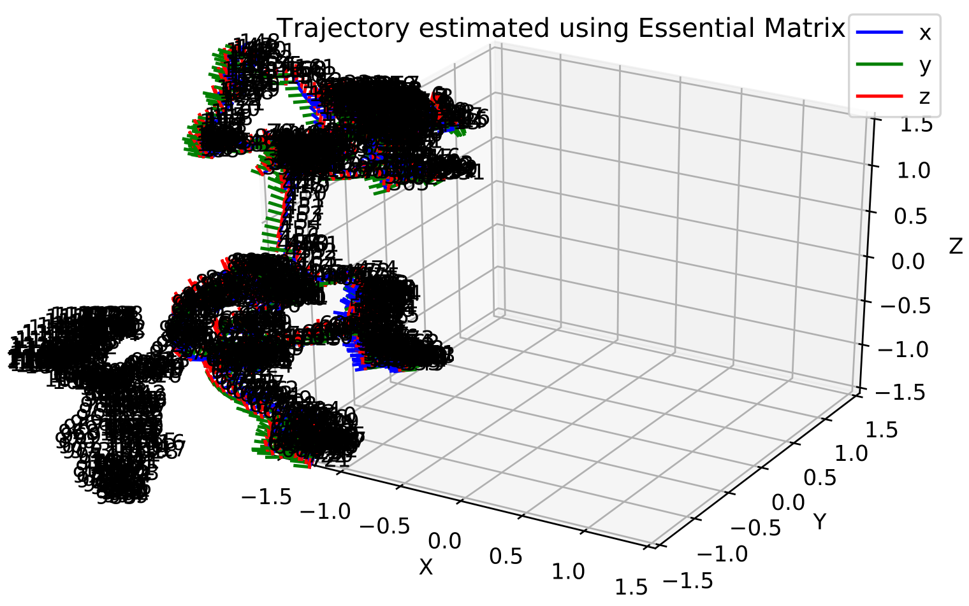
Results – lawnmower
Kabsch
(skip 5)
PnP (skip 5)
Ground truth
Essential Matrix
(skip 5)
Essential Matrix
(skip 20)
Notes:
Different trajectories

Slide 21
RANSAC
1. Randomly sample the minimum amount of points for method
2. Find parameters of model based solely on those points
3. Find all points consistent with that model
4. If proportion of inliers is higher than some threshold, re-estimate model with all inliers. Otherwise go back to step 1
5. If error metric is low enough, halt OR keep going for set number of iterations and keep best parameters
1
2
3
4
5

Slide 22
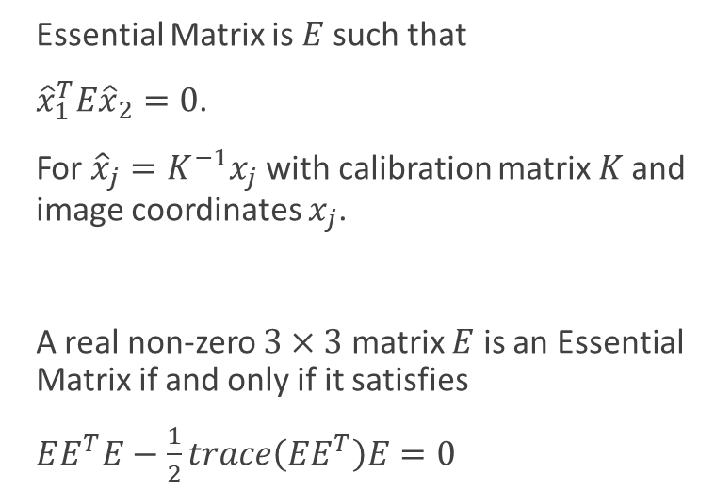
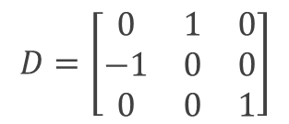
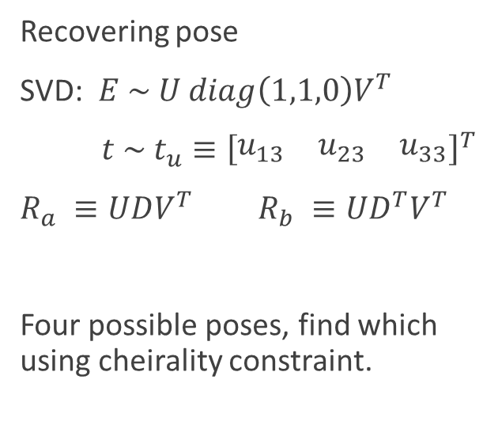

Essential Matrix
Essential Matrix is $E$such that
${\hat{x}}_{1}^{T}E{\hat{x}}_{2}=0$.
For ${\hat{x}}_{j}=K^{−1}x_{j}$ with calibration matrix $K$ and image coordinates $x_{j}$.
A real non-zero $3×3$ matrix $E$ is an Essential Matrix if and only if it satisfies
$EE^{T}E−\frac{1}{2}trace\left(EE^{T}\right)E=0$
Recovering pose
SVD: $E \sim U diag\left(1,1,0\right)V^{T}$
$t \sim t_{u}≡{\left[\begin{matrix}u_{13} & u_{23} & u_{33}\end{matrix}\right]}^{T}$
$R_{a} ≡UDV^{T} R_{b} ≡UD^{T}V^{T}$
Four possible poses, find which using cheirality constraint.
$$D=\left[\begin{matrix}0 & 1 & 0 \\ −1 & 0 & 0 \\ 0 & 0 & 1\end{matrix}\right]$$
Additional constraints are imposed by each point correspondence ${\tilde{q}}^{T}\tilde{E}=0$, where
$$\tilde{q}≡{\left[\begin{matrix}q_{1}q_{1}′ & q_{2}q_{1}′ & q_{3}q_{1}′\end{matrix}\begin{matrix} q_{1}q_{2}′ & q_{2}q_{2}′ & q_{3}q_{2}^{′} \begin{matrix}q_{1}q_{3}′ & q_{2}q_{3}′ & q_{3}q_{3}′\end{matrix}\end{matrix}\right]}^{T}$$
$$\tilde{E}≡{\left[\begin{matrix}E_{11} & E_{12} & E_{13}\end{matrix}\begin{matrix} E_{21} & E_{22} & E_{23} \begin{matrix}E_{31} & E_{32} & E_{33}\end{matrix}\end{matrix}\right]}^{T}$$
Stack the ${\tilde{q}}^{T}$ for the five points, get four matrices which span the right null space of this matrix, $\tilde{X},\tilde{Y},\tilde{Z},\tilde{W}$. Then $E=xX+yY+zZ+wW$ for some scalars $x,y,z,w$. Set $w=1 and s$olve using ${\tilde{q}}^{T}\tilde{E}=0$

Slide 23

Kabsch
Two point clouds: $X, Y$
Centroid: average over all of the points $x_{c}=\frac{1}{N}\sum_{i=1}^{N}{x_{i}}$
To find rotation, want to minimize $E=\frac{1}{2N}\sum_{i=1}^{N}{{\left|x_{i}^{′}−y_{i}\right|}^{2}}$ for $Rx=x′$
SVD: $XY^{T}\sim VSW^{T}$
Optimal rotation is given by $R=WV^{T}.$
This is not necessarily a proper rotation, so we impose $\det{R}=1$ by instead setting
$R=W\left[\begin{matrix}1 & 0 & 0 \\ 0 & 1 & 0 \\ 0 & 0 & d\end{matrix}\right]V^{T}$ with $d=\det{WV^{T}}$

Slide 24


EPnP
Represents reference points $p_{i}$ in terms of four “control points” $c_{i}$
${{}_{}^{W}p}_{i}= \sum_{j=1}^{4}{α_{ij}}$ ${{}_{}^{W}c}_{j}$, ${}_{}^{C}{p_{i}}=\sum_{j=1}^{4}{α_{ij}}{{}_{}^{C}c}_{j}$
$w_{i}\left[\begin{matrix}u_{i} \\ v_{i} \\ 1\end{matrix}\right]=\left[\begin{matrix}f_{u} & 0 & u_{c} \\ 0 & f_{c} & v_{c} \\ 0 & 0 & 1\end{matrix}\right]\sum_{j=1}^{4}{α_{ij}\left[\begin{matrix}{{}_{}^{C}x}_{j} \\ {{}_{}^{C}y}_{j} \\ {{}_{}^{C}z}_{j}\end{matrix}\right]}$
$\sum_{j=1}^{4}{α_{ij}f_{x}{{}_{}^{C}x}_{j}}+α_{ij}{\left(x_{c}−u_{i}\right)}^{C}z_{j}=0$
$\sum_{j=1}^{4}{α_{ij}f_{y}{{}_{}^{C}y}_{j}}+α_{ij}{\left(x_{c}−u_{i}\right)}^{C}z_{j}=0$
Linear system of the form $Mx=0$, $x=\left[\begin{matrix}{{}_{}^{C}c}_{1}^{T} \\ {{}_{}^{C}c}_{2}^{T} \\ {{}_{}^{C}c}_{3}^{T} \\ {{}_{}^{C}c}_{4}^{T}\end{matrix}\right]$
The solution belongs to the kernel of $M$, and can be expressed as
$x=\sum_{i=1}^{N}{β_{i}v_{i}}$,
where $v_{i}$ are the columns of the right singular vectors of $M$. The $β_{i}$ are found using Gauss-Newton optimization.

Slide 25

Projective geometry
Camera model:
$s\left[\begin{matrix}u \\ v \\ 1\end{matrix}\right]=\left[\begin{matrix}f_{x} & 0 & c_{x} \\ 0 & f_{y} & c_{y} \\ 0 & 0 & 1\end{matrix}\right]\left[\begin{matrix}r_{11} & r_{12} & r_{13} \\ r_{21} & r_{22} & r_{23} \\ r_{31} & r_{32} & r_{33}\end{matrix} \begin{matrix}t_{1} \\ t_{2} \\ t_{3}\end{matrix}\right]\left[\begin{matrix}\begin{aligned}X \\ Y\end{aligned} \\ Z \\ 1\end{matrix}\right]$
Projection:
$π\left({}_{}^{I}p\right)=\left(\frac{s\left(u−c_{x}\right)}{f_{x}},\frac{s\left(v−c_{y}\right)}{f_{y}},s\right)$
Reprojection:
$π^{−1}\left({}_{}^{C}p\right)=\left(\frac{xf_{x}}{z}+c_{x},\frac{yf_{y}}{z}+c_{y}\right)$

Slide 26

Relative and absolute errors

Slide 27


Results - errors

Slide 28

Results – computational time

Slide 29







Box investigation

Slide 30



R200 vs D415
First R200
Second R200
D415

